Slide 1
Visualizing the effects of historical events on life and mortality
By Chris Aikman

Slide 2

DATA And audience
The Human Mortality Database

Slide 3

DATA And audience

Slide 4
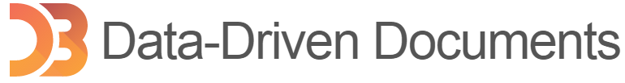
Implementation

Slide 5



Implementation

Slide 6

Live Demo
ONLINE VISUALIZATION DEMO
Click on the first
in the loading screen.

Slide 7
Perception and theory
LIVE WALKTHROUGH
Click on the second
in the loading screen.

Slide 8
Visualization research

Slide 9
Visualization research

Slide 10
Visualization research

Slide 11
User study
Three Question Types
Visualization Layout | Extracting Data | Determining Missing Data

Slide 12
User study

Slide 13
User study

Slide 14
User study

Slide 15
Analysis
Interactive

Slide 16
Analysis
Dynamic

Slide 17
Analysis
Responsive

Slide 18
Analysis
Usable

Slide 19
Analysis
Lack of Data

Slide 20
Analysis
Y-Axis Issues

Slide 21
Analysis
Hover Query

Slide 22
Analysis
Missing Features

Slide 23
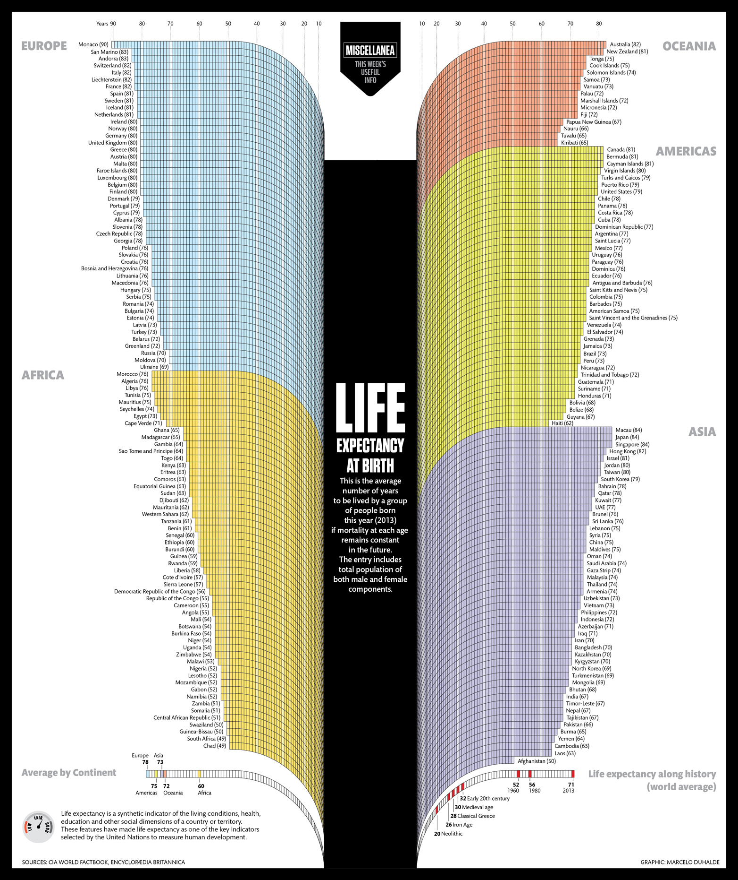
Comparison

Slide 24
Comparison

Slide 25
Comparison

Slide 26
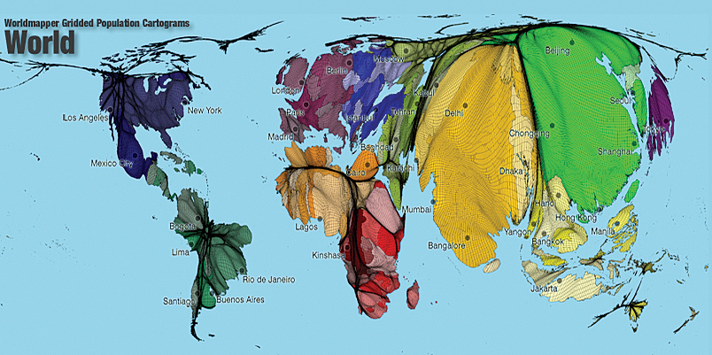
Comparison

Slide 27
Future Work

Slide 28
Future Work

Slide 29
Future Work

Slide 30
Future Work

Slide 31
References
"HMD Main Menu." Human Mortality Database. N.p., n.d. Web. 09 Feb. 2015. <http://www.mortality.org/>.
Bostock, Mike. "Data-Driven Documents." D3.js. N.p., n.d. Web. 01 Mar. 2015. <http://d3js.org/>.
"JQuery." JQuery. The JQuery Foundation, n.d. Web. 28 Jan. 2015. <http://jquery.com/>.
"JQuery UI." JQuery UI. The JQuery Foundation, n.d. Web. 28 Jan. 2015. <http://jqueryui.com/>.

Slide 32
References
Marcelod. "Life Expectancy at Birth." Visualizing.org. Visualizing.org, 15 Jan. 2014. Web. 29 Mar. 2015. <http://visualizing.org/visualizations/life-expectancy-birth>.
Martiner. "Life Expectancy: Progress from 1990 to 2013." Life Expectancy: Progress from 1990 to 2013. Health Intelligence, 22 Dec. 2014. Web. 29 Mar. 2015. <http://healthintelligence.drupalgardens.com/content/life-expectancy-progress-1990-2013>.
Yau, Nathan. "Life Expectancy." Life Expectancy. Flowing Data, n.d. Web. 29 Mar. 2015. <http://projects.flowingdata.com/life-expectancy/>.
Hennig, Benjamin D. "ArcUser Online." Remapping the World's Population. ESRI, n.d. Web. 29 Mar. 2015. <http://www.esri.com/news/arcuser/0110/cartograms.html>.

Slide 33
Questions?

